Slide 1

Intelligent Agent
File Segregation System Powered by Intelligent Agents
Challenges with digital data
File Classification - organisation and segregation of suspicious files
Automate using intelligent agents

Slide 2

Background
Architectural model: Reactive, deliberative and hybrid
Intelligent Agents in AI
Architecture
Communication
Collaboration
Communication: protocols, languages and frameworks
Collaboration with users and other agents to achieve shared goals

Slide 3

Objectives
To develop intelligent agents capable of accurately analysing file name extensions for classification of at least 10 different file types with an accuracy rate of 95% or higher, within a timeline of 10 days.
To create a user-friendly interface that allows users to review and validate the classification results for at least 100 files per session, to provide feedback on any misclassifications, and to record an average user satisfaction rating of 4 out of 5 within a timeframe of 10 days.
To conduct rigorous testing and validation processes on the intelligent agents, including a dataset of 1,000 files representing a diverse range of file types. To achieve an accuracy rate of 90% or higher and ensure that the classification process takes no more than 5 seconds per file, within a timeline of 5 days

Slide 4
Reactive Agent
Methodology
Use of reactive agents for fast and efficient response
Multi Agent
Multi-agent system for file classification
Collaboration
Collaboration and interaction among agents
Notes:
In this presentation, we will delve into the advantages of utilizing a multi-agent system as a practical solution, while also providing detailed insights into our rationale for choosing the reactive type to develop all the agents involved in the project.
To attain a common objective, it is essential to establish coordination and interaction among numerous agents. As described by Wooldridge (2009), these agents collaborate by leveraging their distinct capabilities and knowledge, enabling them to effectively tackle complex tasks that would prove challenging for a single agent. In our project, we are harnessing the potential of multi-agent systems to enhance the efficiency of file classification. By leveraging the collective power of these agents, we can achieve accurate and efficient file classification, leveraging their collaborative abilities.
Now, let's turn our attention to a noteworthy study conducted by Peng et al. (2001) that compared single and multi-agent systems in the domain of file classification. This research meticulously evaluated various criteria, including response time, classification quality, and economic and privacy considerations. Surprisingly, the findings indicated that the collaborative multi-agent system outperformed the single-agent system in all these aspects. These results strongly suggest that adopting a multi-agent system approach holds significant promise for our file classification project. By harnessing the collaboration and interaction among agents, we can achieve superior performance and deliver accurate and efficient file classification results.
Furthermore, we have made a deliberate decision to employ reactive agents in our project. Reactive agents are designed to react and respond to their environment based solely on the immediate input they receive. As explained by Russell (2021), these agents are known for their speed and efficiency, directly perceiving the files and taking action based on the current situation. By incorporating reactive agents into our project, we can ensure a dynamic and real-time response to the classification requirements of the files we encounter. This choice aligns with our goal of delivering a system that is fast, efficient, and capable of adapting to the ever-changing file classification needs.
In summary, the utilization of a multi-agent system offers numerous advantages for file classification, allowing for collaboration and interaction among agents to tackle complex tasks. The comparative study conducted by Peng et al. underscores the superior performance of the collaborative multi-agent system. Moreover, our decision to employ reactive agents ensures a dynamic and real-time response to the classification needs of the files we encounter.

Slide 5
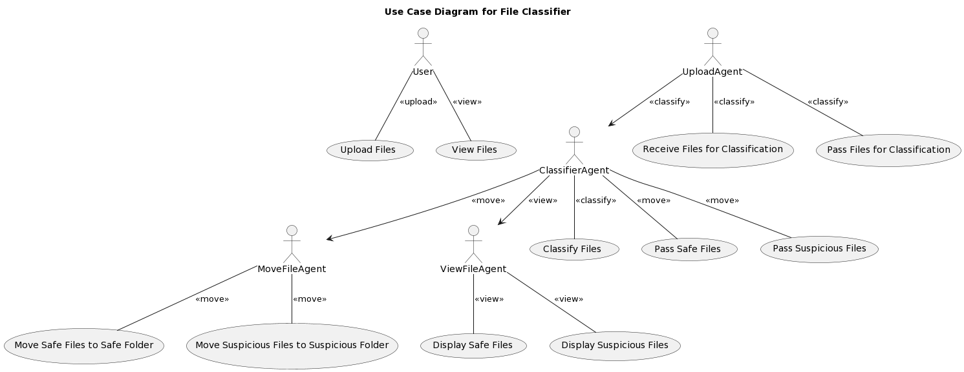
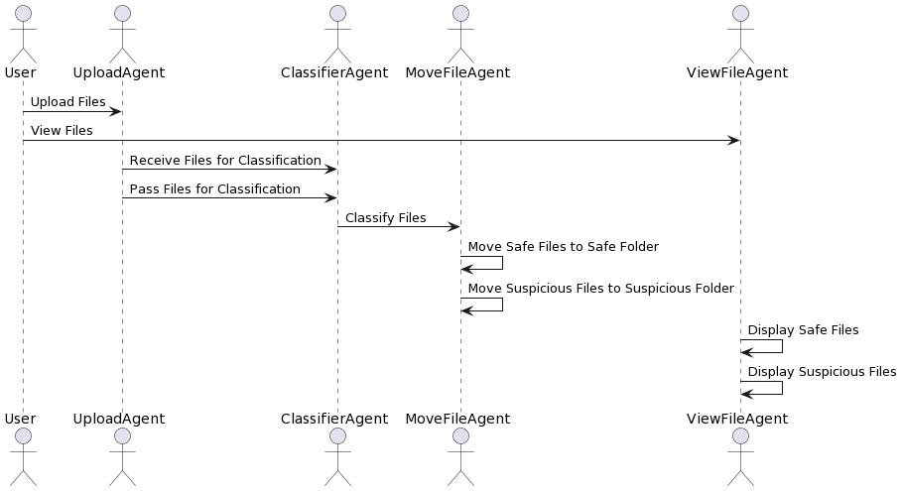
Project Design
Use Case UML
Use case diagrams serve to illustrate the broad functionalities and scope of a system.
Sequence UML
Sequence diagrams employed to highlight specific interaction patterns within the context of the use case.
Notes:
The project's design is visually represented through the utilization of two UML diagrams.
The initial diagram we will discuss is the UML use case diagram. Use case diagrams serve to illustrate the broad functionalities and scope of a system. They also outline the interactions between the system and its associated actors. Within use case diagrams, the use cases and actors outline the system's operations and how actors engage with it. However, these diagrams do not delve into the internal workings of the system (IBM, nd).
The provided UML use case diagram represents the Use Case Diagram for File Classifier. Let's break down the elements and their relationships within the diagram:
Actors:
User: Represents a user who interacts with the File Classifier system.
UploadAgent: An agent responsible for handling the file uploading process.
ClassifierAgent: An agent responsible for classifying the uploaded files.
MoveFileAgent: An agent responsible for moving files to different folders based on their classification.
ViewFileAgent: An agent responsible for displaying files to the user.
Use Cases:
Upload Files: This use case describes the user's ability to upload files to the File Classifier system.
View Files: This use case represents the user's ability to view the files within the system.
Relationships:
The user is associated with the "Upload Files" and "View Files" use cases, indicating their involvement in these actions.
The uploadAgent is connected to the "Receive Files for Classification" and "Pass Files for Classification" use cases, indicating its role in handling the file upload process.
The classifierAgent is linked to the "Classify Files," "Pass Safe Files," and "Pass Suspicious Files" use cases, representing its responsibility for classifying the files and passing them to the appropriate agents based on their classification.
The moveFileAgent is connected to the "Move Safe Files to Safe Folder" and "Move Suspicious Files to Suspicious Folder" use cases, illustrating its role in moving files to the respective folders based on their classification.
The viewFileAgent is associated with the "Display Safe Files" and "Display Suspicious Files" use cases, indicating its responsibility for displaying files to the user.
Additionally, there are arrows between the agents, representing the flow of actions and information:
The uploadAgent connects to the classifierAgent, indicating that it passes the uploaded files for classification.
The classifierAgent is connected to both the moveFileAgent and the viewFileAgent, suggesting that it interacts with them to perform the necessary actions related to file movement and display.
Overall, this use case diagram provides an overview of the high-level functionalities and interactions between the actors and agents in the File Classifier system.
Next, we will shift our focus to the Sequence UML diagram. Sequence diagrams are employed to highlight specific interaction patterns within the context of the use case (Bernardi, 2002). Its illustrates the dynamic interactions within our system. This diagram captures the specific patterns of interaction between the actors involved in the use case.
In the diagram, we have five actors: User, UploadAgent (UA), ClassifierAgent (CA), MoveFileAgent (MA), and ViewFileAgent (VA). Each actor plays a distinct role in our system.
Firstly, the User initiates the process by uploading files to the system, indicated by the arrow from User to UA, representing the action "Upload Files." Additionally, the User can view files in the system, as shown by the arrow from User to VA, denoting the action "View Files.“
Upon receiving the uploaded files, the UploadAgent (UA) interacts with the ClassifierAgent (CA). This interaction is depicted by the arrows from UA to CA, representing the actions "Receive Files for Classification" and "Pass Files for Classification." This handover of files allows the ClassifierAgent (CA) to take over the classification process.
Next, the ClassifierAgent (CA) proceeds to classify the files, as indicated by the arrow from CA to MA, representing the action "Classify Files." This step ensures that each file is appropriately labeled as safe or suspicious.
Subsequently, the MoveFileAgent (MA) takes charge of moving the classified files to the respective folders. The diagram shows two self-arrows from MA to MA, signifying the actions "Move Safe Files to Safe Folder" and "Move Suspicious Files to Suspicious Folder." This internal interaction within the MoveFileAgent (MA) ensures the proper relocation of the files.
Simultaneously, the ViewFileAgent (VA) is responsible for displaying the classified files to the User. This is represented by the self-arrows from VA to VA, symbolizing the actions "Display Safe Files" and "Display Suspicious Files." These actions allow the User to visualize the files categorized as safe or suspicious.
In summary, the Sequence UML diagram emphasizes the sequential interactions between the actors in our system. The User uploads files, which are then received and passed for classification by the UploadAgent (UA). The ClassifierAgent (CA) classifies the files and passes them to the MoveFileAgent (MA) for appropriate folder allocation. Meanwhile, the ViewFileAgent (VA) ensures the display of the classified files to the User.

Slide 6
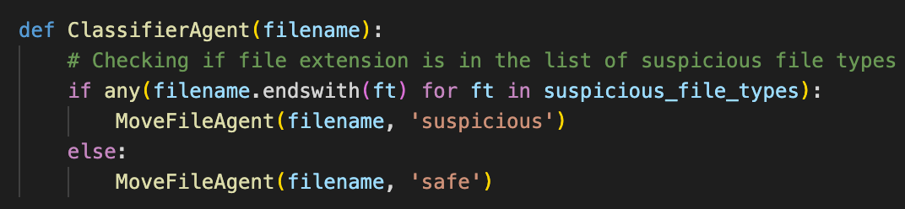
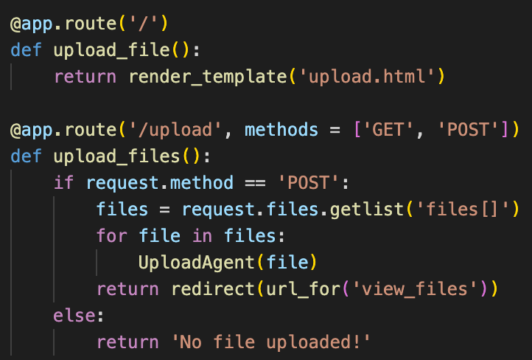
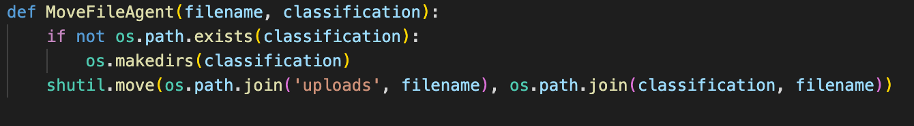
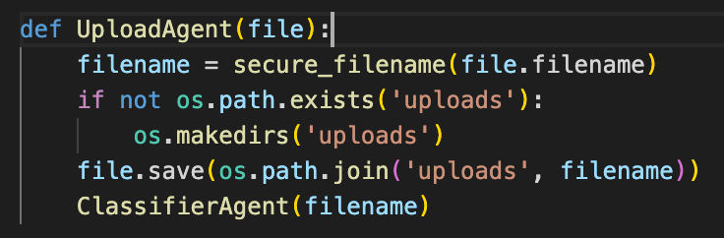
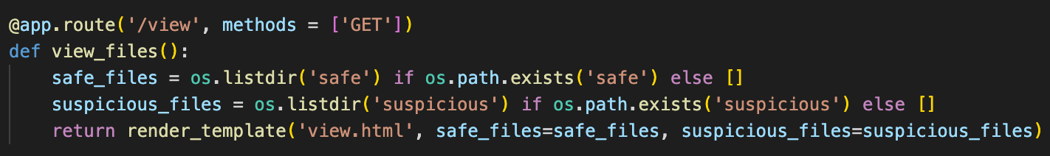

Developments
Upload Agent
Classifier Agent
Secure file uploads
Classify files based on extensions
Move File Agent
Move files to designated folders
View File Agent
Display files to the user

Slide 7
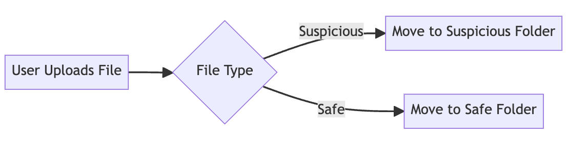
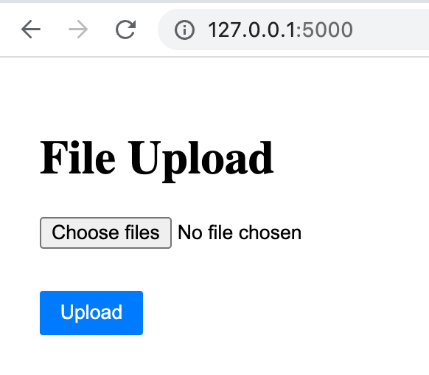
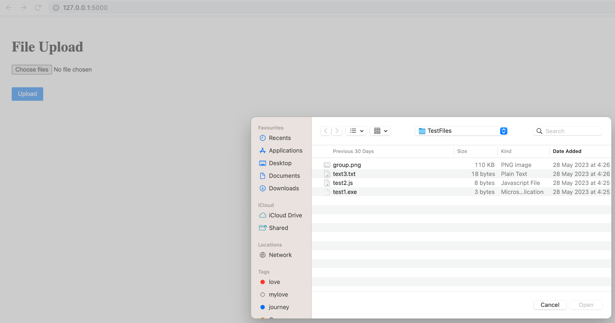
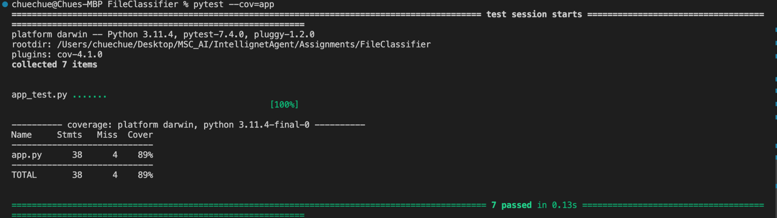
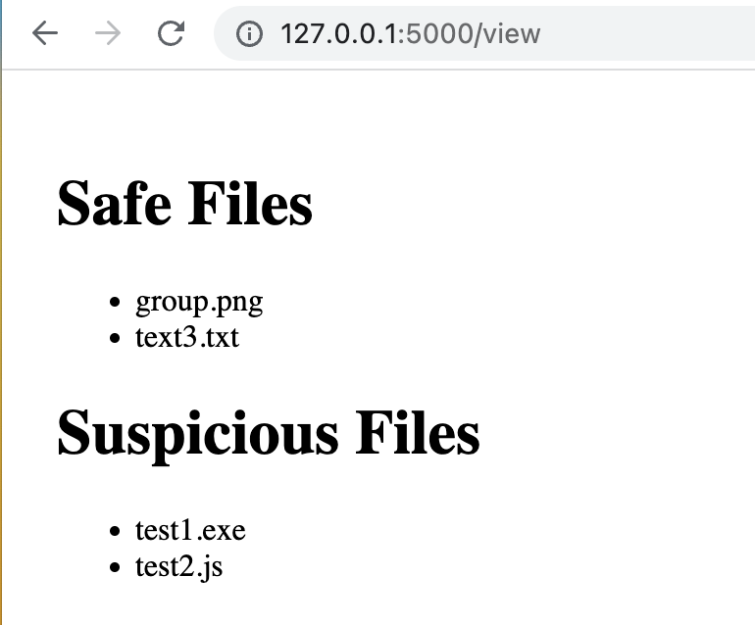
Testing and Evaluation
Objective: Ensuring functionality, identifying issues, evaluating performance, user satisfaction.
Test Types:
Unit: Checks functions.
Integration: Reveals interaction faults.
System: Confirms compatibility.
Performance: Analyzes behavior under load.
UAT: User satisfaction confirmation.
Tools:
Python's unittest for test cases.
pytest-cov and coverage to measure test coverage
Figure 7.2 System Process
Figure 7.3 File Upload UI
Figure 7.4 File Browser UI
Figure 7.1 Unit Test Result
Figure 7.5 Result of Classified Files UI

Slide 8
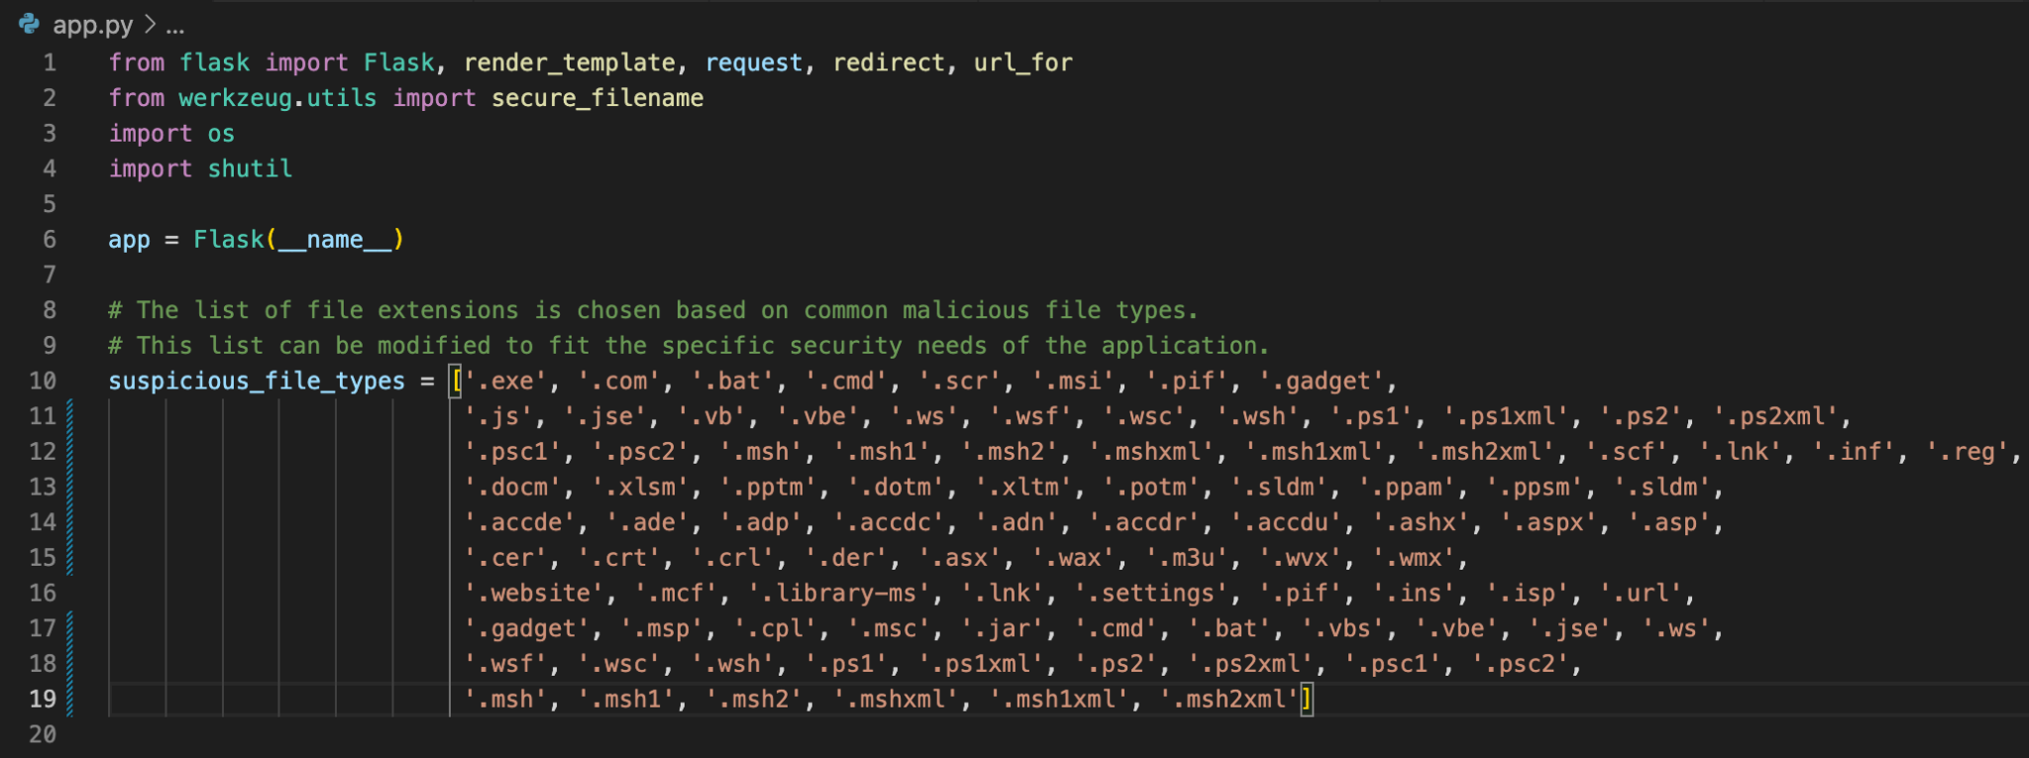
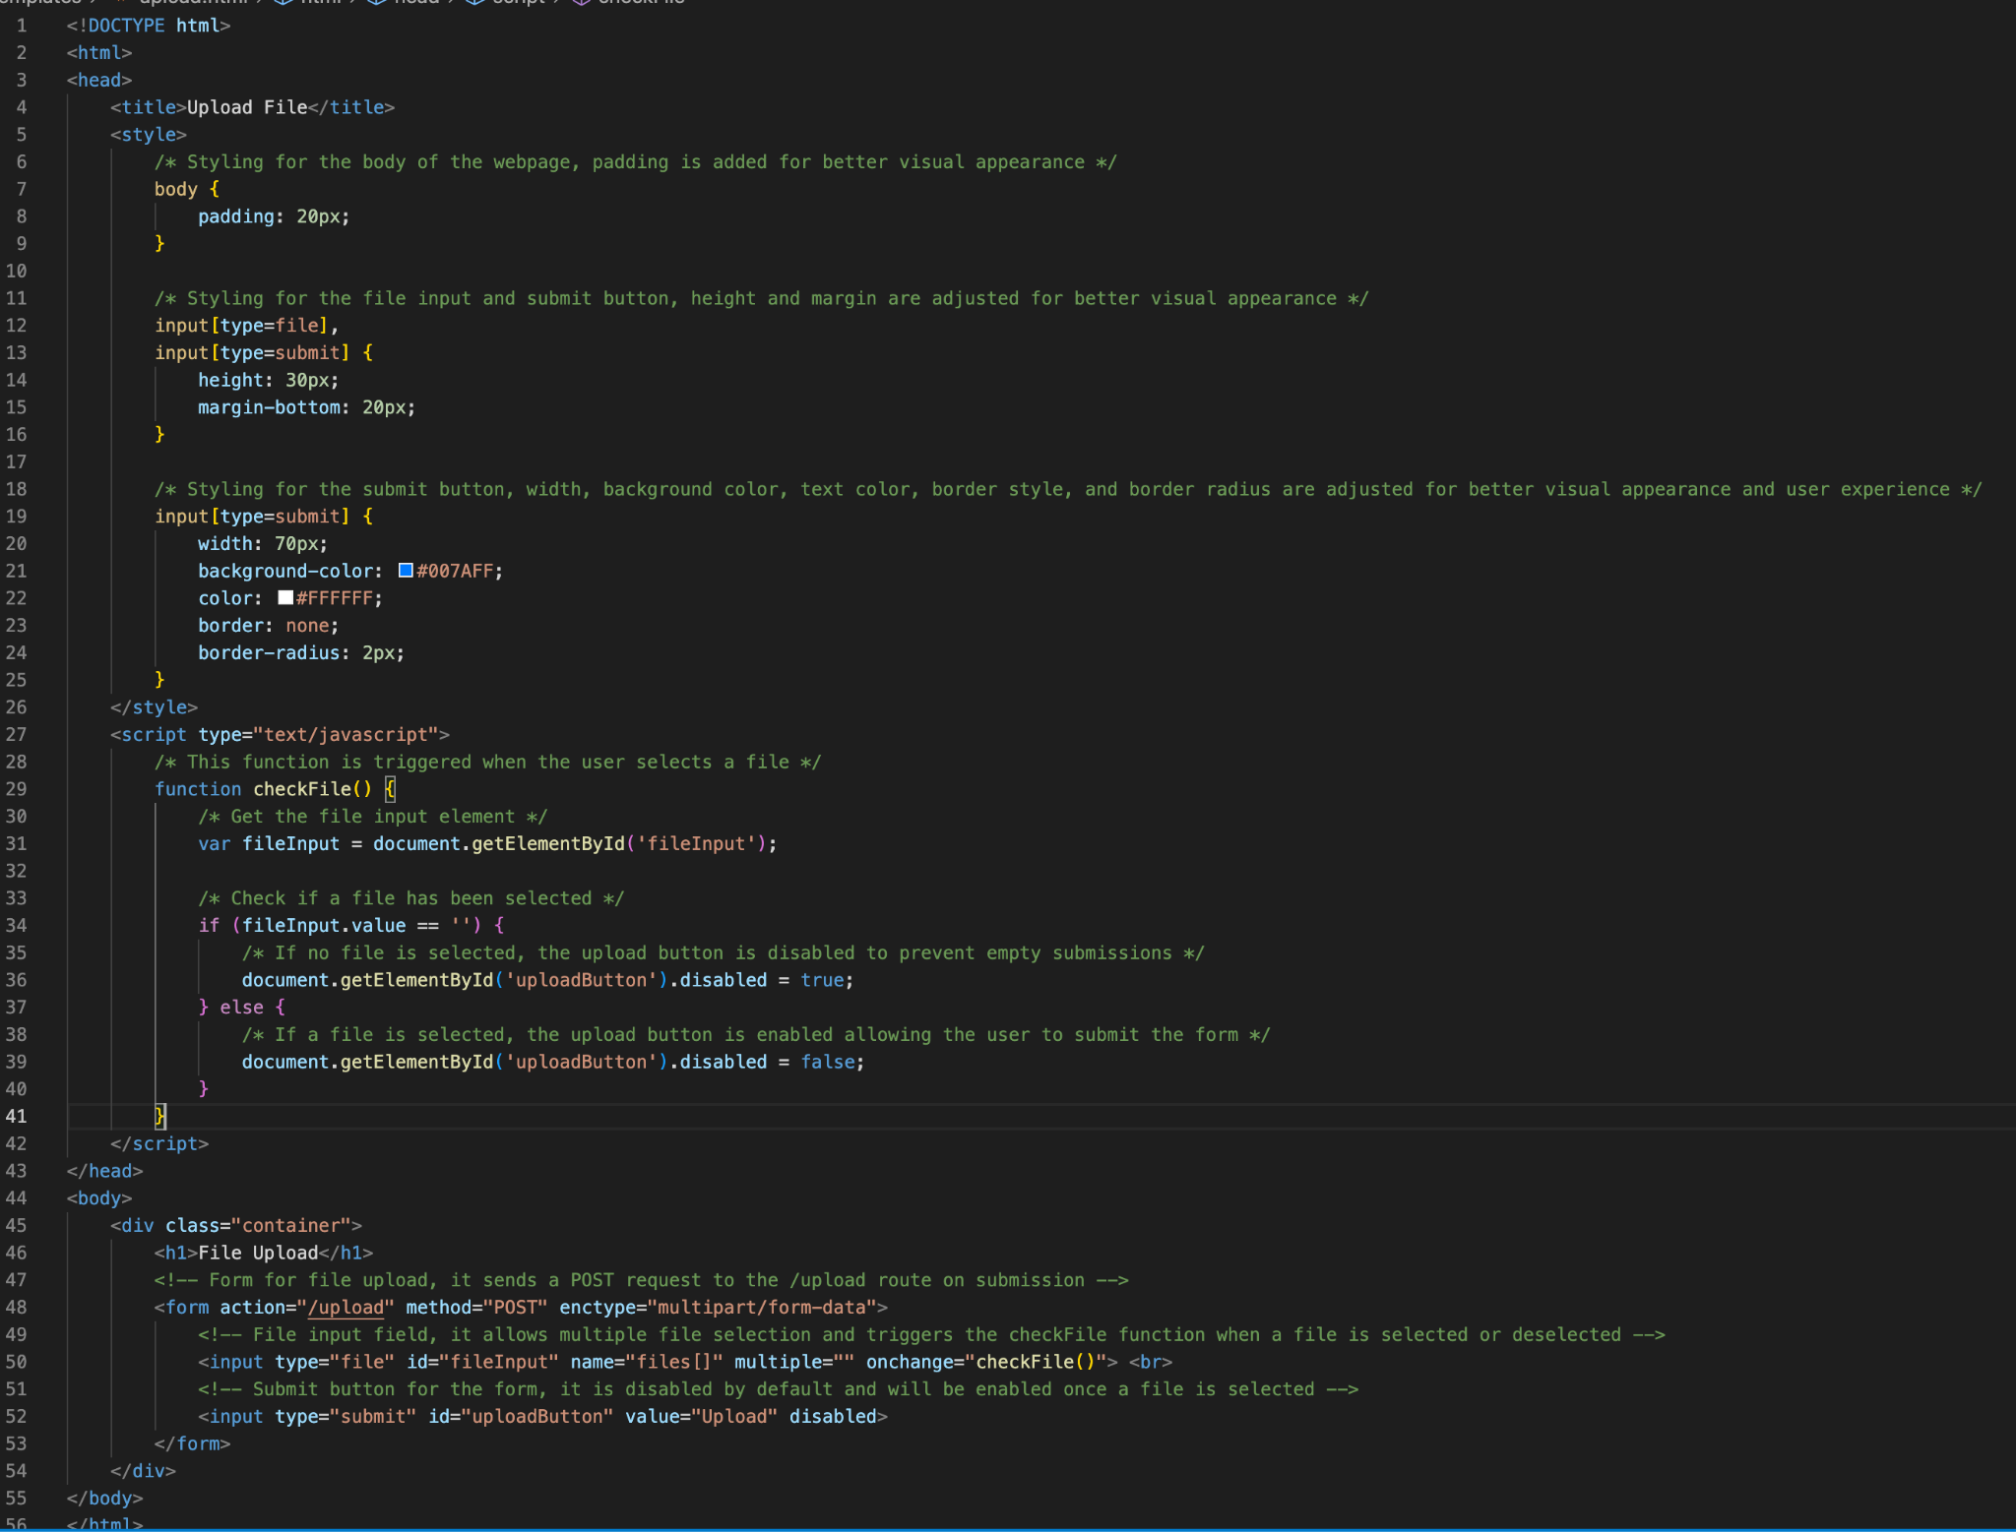
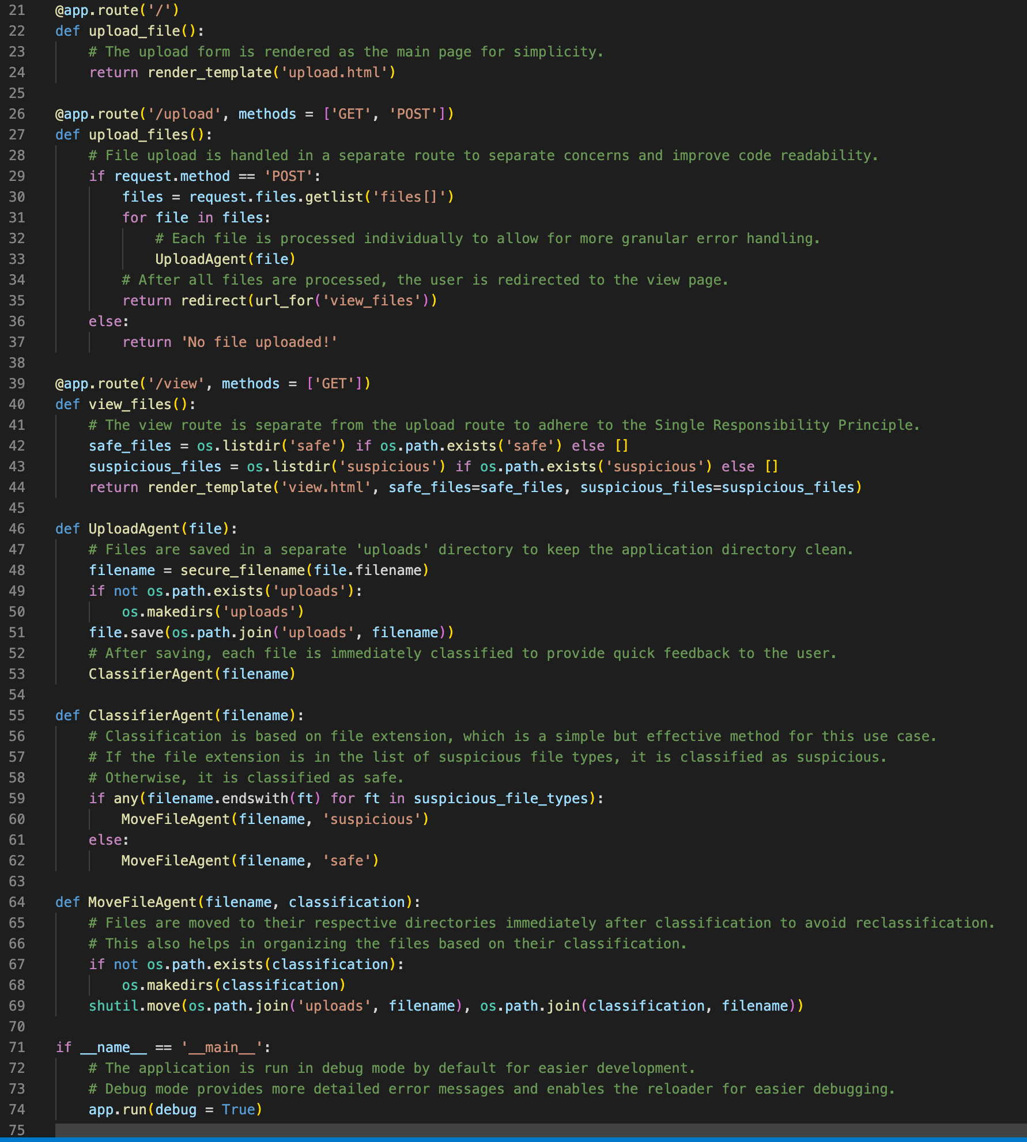
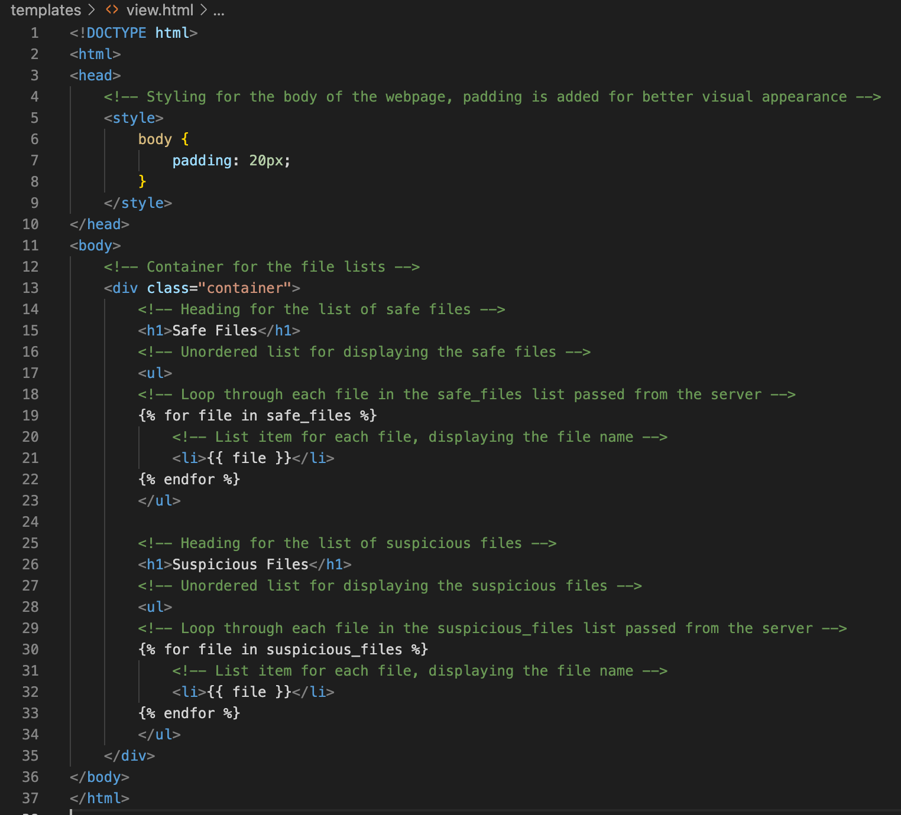
Programming Approach
app.py
Programming approach: Python programming
Flask: Lightweight framework for building web interfaces
Werkzeug: Ensures security in file handling and communication
os: Handles operating system-dependent functionalities
shutil: Performs high-level file operations and management
upload.html
HTML template for the file upload page.
Allows users to select and upload files.
Includes JavaScript code for handling file selection and enabling/disabling the upload button.
view.html
HTML template for the file viewing page.
Displays the list of files categorized as "safe" and "suspicious".
Utilizes Flask template syntax to dynamically populate the file list.
upload.html
app.py
view.html

Slide 9
Challenges
and Solution
Accuracy
Accurate file classification
Guaranteeing accurate file classification and securing file uploads are paramount challenges in our development process
Security
Secure file upload to prevent attacks
Validation
Testing and validation
Notes:
One of the key challenges we anticipate in the development process revolves around ensuring the precise classification of files. The conventional method of relying solely on file extensions can be misleading, particularly if a malicious file is disguised with a benign extension (Casey, 2011). Therefore, it becomes crucial for us to implement a robust mechanism that goes beyond file extensions to accurately identify and classify files.
Another critical concern is ensuring secure file uploads to mitigate the risk of directory traversal attacks. This type of attack occurs when an attacker manipulates file paths to access unauthorized directories and potentially compromise the system's security. To address this concern, we need to implement effective input validation techniques and conduct regular security testing (Stuttard & Pinto, 2011). By doing so, we can minimize the vulnerability to directory traversal attacks and safeguard the integrity and security of our file classification system.
In summary, guaranteeing accurate file classification and securing file uploads are paramount challenges in our development process. We need to overcome the limitations of file extensions by adopting a more comprehensive approach to classification. Additionally, implementing robust input validation and conducting regular security testing will fortify our system against directory traversal attacks and bolster its overall security posture.

Slide 10


Overall, a multiagent system for file classification harnesses the power of multiple autonomous agents to achieve efficient and accurate file organization. By leveraging their complementary capabilities and enabling collaboration, such systems can enhance file management, retrieval, and decision-making processes in diverse domains
Thanks

